Slide 1
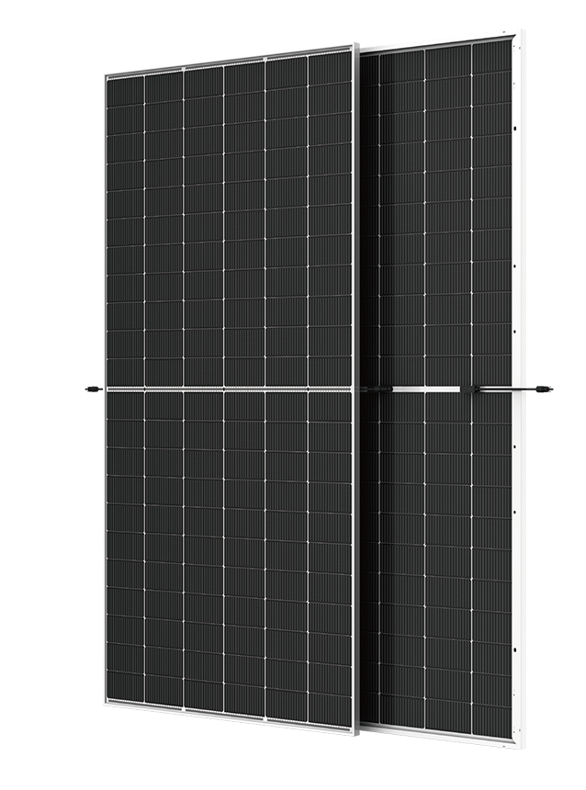












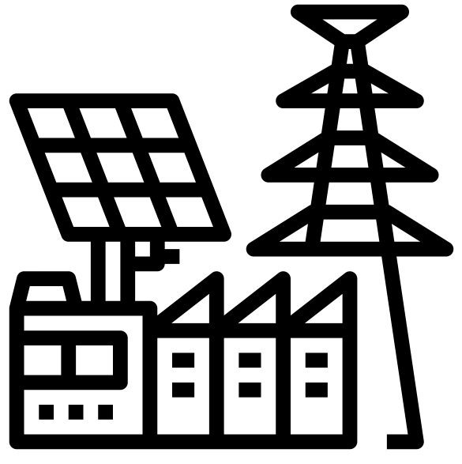








ABS-132GGS-G12
705W – 725W
Topcon Half Cut PV Module
Glass/Glass-Silver Frame
725W
MAXIMUM POWER OUTPUT
+10W
OUTPUT POSITIVE TOLERANCE
Guaranteed 0~+10W positive tolerance ensures power output reliability.
23.3%
MAXIMUM EFFICIENCY
KEY FEATURES
LINEAR PERFORMANCE WARRANTY
LOW SYSTEM COST
Higher yield per surface area, lower BOS costs, higher power classes, and an efficiency rate of up to 23.34%.
100%
99%
95%
^{A}DDED VALUE FROM WARRANTY
Guaranteed Power Performance
87.40%
EXTREME WEATHER RATING
High-tech aluminum alloy frame, certified for high snow (5400 Pa) and wind loads (2400 Pa).
90%
85%
80%
1
5
10
15
20
25
30
ADVANCED MODULE TECHNOLOGY
Highest reliability & enhanced crack tolerance MBB module
Product warranty
30
Years
years
30-year Warranty for Extra Linear Power Output
ALL-WEATHER TECHNOLOGY Optimal
Yields, whatever the weather, with low-light and temperature behaviour.
Product warranty
12
Years
12-year Warranty for Materials and Processing (1st year ≤ 1.0%, 2nd~30th years ≤ 0.40% / year)
BETTER TEMPERTURE COEFFICIENT
Lower temperature coefficient (Pmax):
-0.30%/°C, increases energy yield in hot climate
THE IDEAL SOLUTION FOR
PID
ENDURING HIGH PERFORMANCE
Anti LID and Anti PID Technology. Under long-term production safety conditions, the limited power degradation caused by the PID effect is guaranteed.
Residential
Commercial
Off-Grid
Utility
COMPREHENSIVE CERTIFICATES
ADVANTAGES
IEC 61215 | IEC 61730 | IEC 61701 | IEC 62716
MADE IN UAE
Premium products are 100% made in the Emirates.
A RELIABLE INVESTMENT
Products up to 725Wp, 30 years of performance warranty.
ENCOURAGING INNOVATION
Innovative, prestigious, European production technology
UL 61730 | CEC | ISO 9001 | ISO 14001| ISO 45001
Address: Abundance Solar Panels Industries – LLC Plot No 7-8, KHIA5, KEZAD, Abu Dhabi, UAE

Slide 2
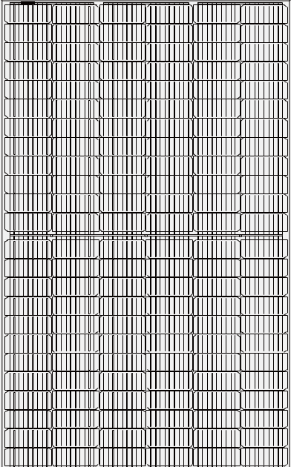


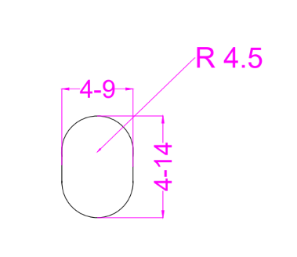
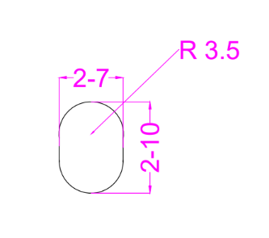
ABS-132GGS-G12-705-725W
ENGINEERING DRAWINGS & TECHNICAL PARAMETERS
ELECTRICAL CHARACTERISTICS (STC/NOCT)
Models | Maximum Rating Power (Pmax) (W) |  | Open Circuit Voltage (Voc) (V) |  | Maximum Power Voltage (Vmp) (V) |  | Short Circuit Current (Isc) (A) |  | Maximum Power Current (Imp) (A) |  | Module Eﬃciency (EFF)(%)
 | STC | NOCT | STC | NOCT | STC | NOCT | STC | NOCT | STC | NOCT
ABS-132GGS-G12-705 | 705 | 527.0 | 47.06 | 44.25 | 40.57 | 37.85 | 18.10 | 14.61 | 17.43 | 13.96 | 22.70%
ABS-132GGS-G12-710 | 710 | 530.7 | 47.17 | 44.35 | 40.66 | 37.94 | 18.14 | 14.64 | 17.54 | 14.05 | 22.86%
ABS-132GGS-G12-715 | 715 | 534.4 | 47.22 | 44.40 | 40.71 | 37.98 | 18.17 | 14.66 | 17.59 | 14.09 | 23.02%
ABS-132GGS-G12-720 | 720 | 538.2 | 47.34 | 44.51 | 40.81 | 38.08 | 18.21 | 14.69 | 17.69 | 14.17 | 23.18%
ABS-132GGS-G12-725 | 725 | 541.9 | 47.44 | 44.60 | 40.90 | 38.16 | 18.23 | 14.71 | 17.79 | 14.25 | 23.34%
*Standard Test Condition (STC): Cell Temperature 25 °C, Irradiance 1000 W/m², AM 1.5, Nominal module operating temperature (NMOT): Air mass AM 1.5, Irradiance 800W/m², temperature 20°C, windspeed 1 m/s. Reduction in eﬃciency from 1000W/m² to 200W/m² at 25°C: 3.5 ± 2%. *Values without tolerance are typical numbers. Measurement tolerance: ± 3%```
BI-FACIAL OUTPUT-BACKSIDE POWER GAIN
Models |  | ABS-132GGS-G12-705 | ABS-132GGS-G12-710 | ABS-132GGS-G12-715 | ABS-132GGS-G12-720 | ABS-132GGS-G12-725
10% | Power | 776 | 781 | 787 | 792 | 798
 | Eff | 24.96% | 25.14% | 25.32% | 25.50% | 25.67%
15% | Power | 811 | 817 | 822 | 828 | 834
 | Eff | 26.10% | 26.28% | 26.47% | 26.66% | 26.84%
20% | Power | 846 | 852 | 858 | 864 | 870
 | Eff | 27.23% | 27.43% | 27.62% | 27.81% | 28.01%
25% | Power | 881 | 888 | 894 | 900 | 906
 | Eff | 28.37% | 28.57% | 28.77% | 28.97% | 29.17%
Solar Cell | Topcon 210 x 105 mm G12 ,18BB
No.of cells | 132 (6×22)
Dimensions | 2384 mm x 1303 mm x 30 mm ( 93.85” x 51.30“ x 1.18” inch)
Weight | 39 kg / 85.98 lbs.(±3%)
Front Glass | 2.0 mm, High Transmission, Low Iron, Tempered ARC Glass
Cell Encapsulation | EPE(Expanded polyethylene) & EVA (Ethylene-Vinyl-Acetate)
Back Glass | 2.0 mm Semi Tempered Glass with Glaze
Frame | Silver Anodized Aluminum Alloy Type 6005T6 , Silver Color
Junction Box | IP68, 1500VDC, 3 Bypass Diodes
Connectors Type | IP68 MC4 Compatible
Cable | 400mm or 1300 mm, 4mm²
Package Conﬁguration | 36 pcs Per Pallet, 648 pcs per 40’ FT container ( Two pallets=One stack )
CURRENT-VOLTAGE CURVE UNDER DIFFERENT IRRADIANCE

